Slide 1


IPTV Over ICN
G. Xylomenos , A. Phinikarides
I. Doumanis, X. Vasilakos,
Y. Thomas, D. Trossen.
M Georgiades, S. Porter
Packet Video 2018

Slide 2
Motivation

Slide 3
What is POINT about?
Getting ICN to the real world
  Individual ISP uses POINT for its core network
  Optimization of specific services (incl. video)
The POINT trials
  Using real network, content and users
  Tested both IPTV and HLS services
    Focusing here on IPTV over IP Multicast
    IGMP Snooping replaced with SDN switches

Slide 4
POINT Concepts

Slide 5
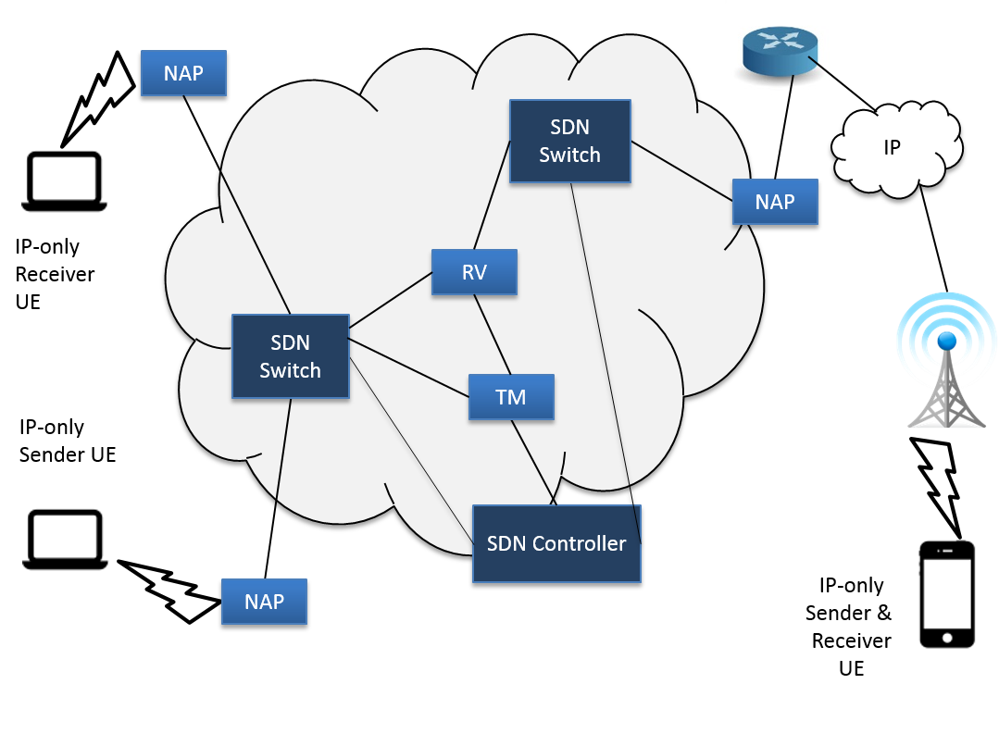
The POINT concept
ICN core serving IP traffic

Slide 6
POINT novelties
Plain SDN switches used
  ODL controller app maps POINT to SDN
Network Access Points (NAPs) at edges
  Traffic conversion from/to IP
Source routing between NAPs
  Bitfield-based forwarding, native multicast
  Multicast path created by ORing unicast paths

Slide 7
IPTV and POINT

Slide 8
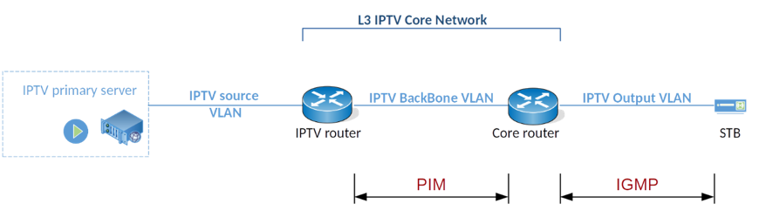
Regular IPTV
PIM in core, IGMP in metro and access
Stateful IGMP snooping switches
  Peek inside IGMP traffic
  Learn where streams come from
  Learn where streams should go to

Slide 9
POINT IPTV
Transparent mapping of IP datagrams to ICN
  Each IP Multicast group mapped to two channels
  One named channel for control messages
    Sender-side NAP subscribes to control channel
    Client-side NAPs publish control messages
  One named channel for data messages
    Client-side NAPs subscribe to data channel
    Sender-side NAP publishes to data channel

Slide 10
IP Multicast vs. POINT
What happens when a link fails?
Regular IPTV: re-learn everything (slow)
  Switch to new spanning tree
  Learn new paths to sources and receivers
POINT IPTV: switch paths (fast)
  SDN switches use path from failover group
  New paths can be used later by NAPs

Slide 11
The POINT Trial

Slide 12
The closed trial
Took place at PrimeTel in Cyprus
  Actual network with IP and POINT side by side
  Content from production video servers
  Regular STBs and TVs in PrimeTel’s HQ
  Volunteer users watched videos
  Links failed and were replaced while viewing
  Questionnaires and interviews to assess QoE
  QoS monitored throughout

Slide 13
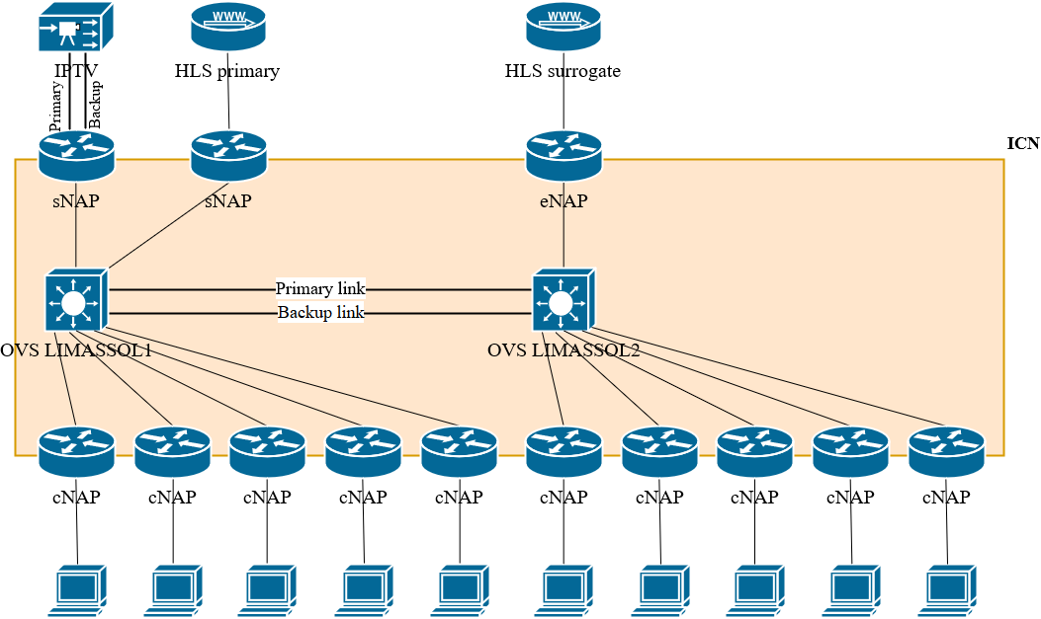
Trial network

Slide 14
QoS evaluation
Primary ink failover (IP)
Primary link failover (POINT)

Slide 15
QoE evaluation
Adapted i-QoE questionnaire
  Perception of video with IP vs. POINT
    Viewers watched a set of videos
    No idea which network was used when
  Q. 18: “Did you perceive any visual impairments in the video?”
  Statistical analysis indicates POINT was better
    4.35 (StDev 0.81) vs. 2.00 (StDev 1.31) on 5-point scale

Slide 16
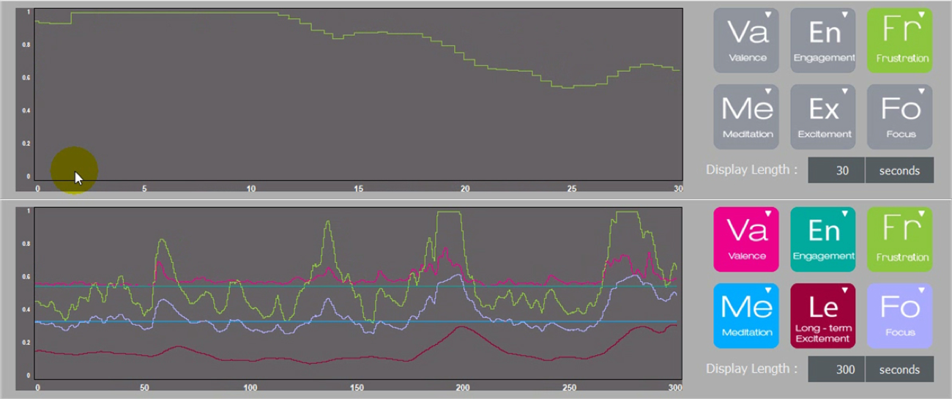
EEG measurements
Brain activity while watching video
  Sample output with IP network
  Frustration grows when link is disrupted

Slide 17
CONCLUSION

Slide 18
What came out of this?
POINT is first ICN project to hold trials
  Closed: at PrimeTel HQ with QoE evaluation
  Open: ran for weeks but with fewer QoE data
Will POINT replace IP for IPTV?
  Performance-wise, no! Availability-wise, maybe.
  POINT shifted its focus to adaptive streaming
    Goal: make DASH cheap enough for live TV
    But, that is a different paper…

Slide 19
Thank you
xgeorge@aueb.gr

